Slide 1












Integrated CI Dashboard Pilot Proposal – GSK
Copyright © 2019 Techwave. All Rights Reserved.

Slide 2
CI Dashboard – GSK Requirement and Techwave Solution
Pilot Scope:
GSK team is following a labour Intensive approach in :
Manual data collation on key indications or competitors
Manual tracking of clinical trial registry websites for data collation
Manual update of master data tables
High demand on analyst time
Techwave Solution as part of Pilot :
Integrated CI Dashboard with Clinical Trials data from Clinicaltrials.gov, Chinese Clinical Trial Registry and Trialtrove
Intelligent data search functionality to the user to search the specific clinical trial in minimal time.
Alerts and notifications to the user in case any change in extracted information as compared to previous one is detected
Download of complete clinical trial data in user designed fashion and use it for their regular purpose, which they are doing it manually.
Download log of history of changes detected in the clinical trials, which helps user to do quick analysis on trial progress and competitive tracking which saves analyst time.

Slide 3




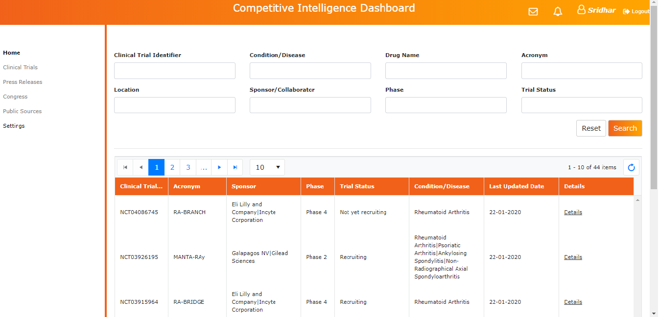










Proposed Solution – Technology combined with Pharma
Knowledge
Deep functional knowledge
With no key changes
CT.Gov Trialtrove
Chinese
API
Periodic
calls
Techwave
Local
System’s
Defined
websites with
fields
Data scraping Engine
Data Processing
‘Alerting Engine’
Mechanism
Req. Gathering & Data Understanding
With key Changes
User Interface and Alert Engine
Data Extraction
Data Ingestion
Data Processing
CI Tool

Slide 4
CI Dashboard – Pilot Technology Stack
Data Science Components (Data Extraction) :
Python 3.8 Version
Anaconda Navigator
Jupyter/Spyder Notebooks
Microsoft Excel 2010
User Interface Components :
.NET Framework 4.7
ASP.NET MVC 5 Framework
SeaSharp, Ad dot net
Access Database engine
Html, CSS, jQuery, Kendo
Cloud Components for Deployment:
- Azure

Slide 5
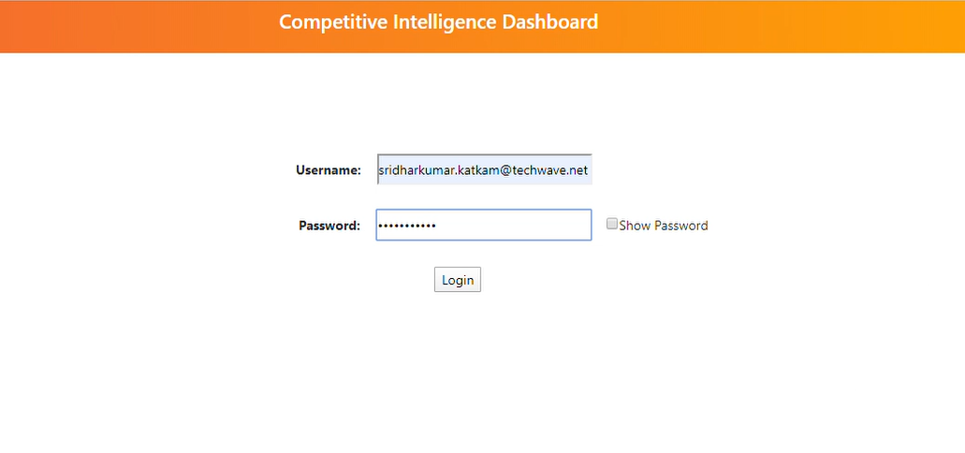
CI Dashboard - Log In Screen

Slide 6
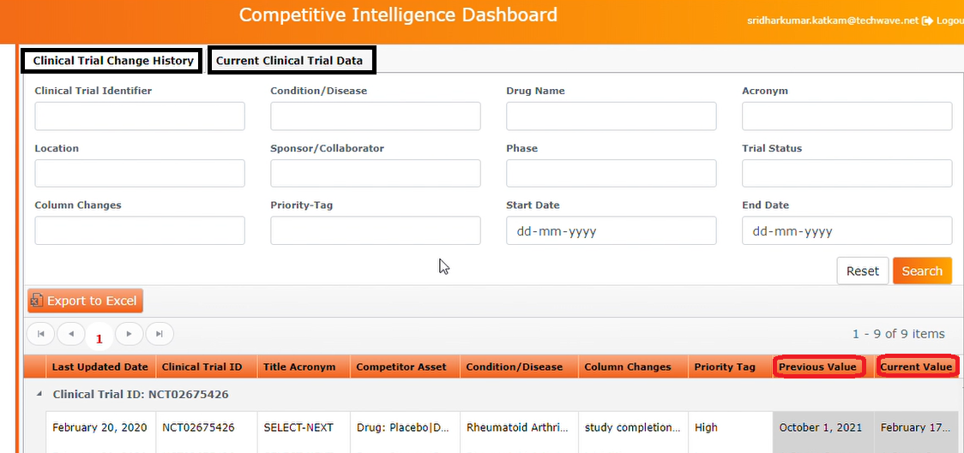
CI Dashboard - History of Clinical Trial Changes Screen

Slide 7
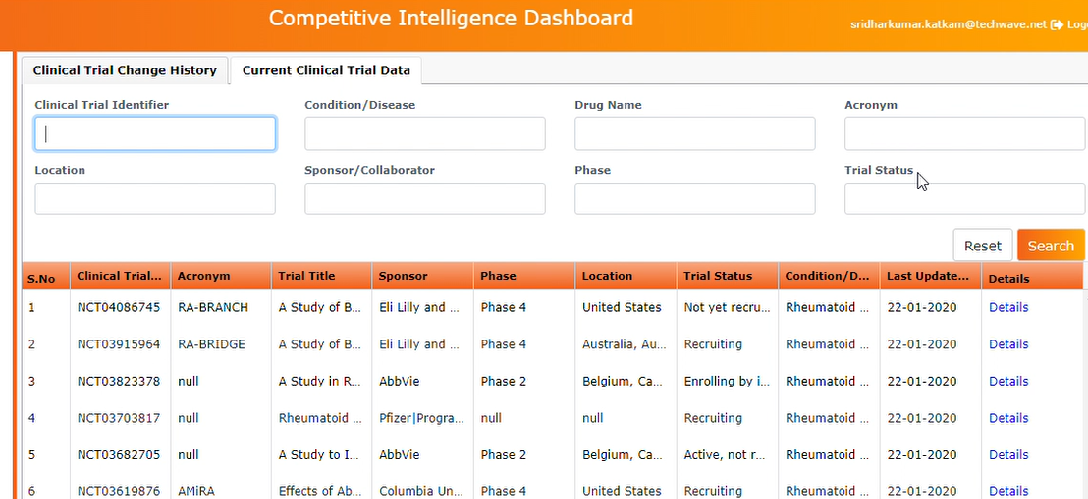
CI Dashboard - Current Clinical Trials Screen

Slide 8
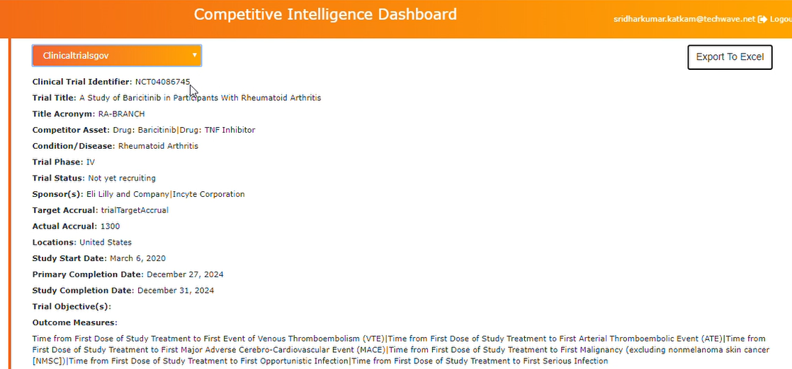
CI Dashboard - Current Clinical Trial Details Screen

Slide 9
CI Dashboard – Pilot To Full Blown Solution
Data Extraction :
Data extraction code is been written for Clinical Trials .gov , Chinese Trial Registry and Trialtrove websites. Data is been extracted for three Indications provided by GSK (Rheumatoid Arthritis, Psoriatic Arthritis and Axial Spondylitis).
Code starts executing with input of an Clinical Identifier for the specific websites. If GSK wants to extend to another Indications. Clinical Identifier’s related to the additional indications needs to be provided.
If new trial registries need to be included for data extraction, then Techwave team needs to check the Server Handshake functionality with those websites and if everything works fine, data extraction code will be written, tested, loaded to the CI dashboard within an agreed timeline.
Data Storage :
As of now, data storage is been done on excel/csv files on Techwave systems and data flows to CI dashboard. In full blown solution a database will be designed/created by Techwave team and make date to flow from database to existing CI dashboard.
User Interface (CI Dashboard):
With the final feedback given by Client (if any), UI will be deployed on Cloud, gets data from database and
serve the Client

Slide 10
CI Dashboard – Adding Additional Modules
Techwave wishes to add new modules to the existing CI Dashboard as below :
Competitor Press Releases:
Press releases from competitor websites will be scraped/crawled with respect to competitor’s drug molecule, trial acronym or any kind of keywords related to competitor business specified by client and send an email alerts, notifications to client mailbox on daily basis or user specific frequency. Alerts will be User specific and Keywords specific.
Along with email alert functionality, extracted press releases content will be displayed in UI in separate tabs. User can check the various press releases using Intelligent data search functionality provided.
Healthcare Congress Module :
Major healthcare congress will be scraped with respect to client specified diseases, drug molecule, author’s, journal’s or any kind of keywords specified by Client and send an email alerts to client mailbox on daily basis or user specific frequency. Alerts will be User specific and Keywords specific.
Visualizations for Data Analysis:
Standard charts will be created using advanced visualization technologies such as Tableau, Qlik and Power BI
Allow experts to add notes and insights related to product launch etc. on provided Clinical Trials and Press Releases
Share insights and results with other users along with downloaded reports, graphs and visualization from CI dashboard

Slide 11
Thank You
Credits - HBR

